Slide 1
Presentation user guide
V2.01
07/12/22

Slide 2
Presentation User Guide
3. About Template
4. Common Rules
  General slide rules
  Title & Thank you slides
  Table of contents slides
  Presentation slide layout
  Clip art
11. Examples
  Principal presentation
  Straw poll results
  Company organisation
  TranzWare Fraud Analyzer

Slide 3
About the template
Presentation User Guide
The template is designed to develop the following:
Original presentations
  Company background and profile presentation
  Products and solutions presentation
  Sales proposal presentation
  Event/Conference presentation
  Training presentation
  Meeting presentation
Business documents
  Organisation charts
  Project overviews, project progress and status reports
  Products and Solutions overviews
  Financial performance & management reports

Slide 4
Common rules

Slide 5
General rules
Common rules
Arial Bold font only
Only use slide layouts from Template
No special effects added to pictures, charts, tables
Using larger fonts is better, although try to keep font size consistent over the presentation
Do not use fonts smaller than 12pt, except for a small proportion of very detailed complex diagrams where smallest font size is 8pt
Use capital letters for SLIDE TITLES, capitalize all words
Please choose the optimum position for the first bullet and maintain this throughout the presentation, changing position only when appropriate
Some page templates are split into sections divided with a solid line, use at own discretion
If you have one line on a slide judge it as “caption” – do not put a bullet in front of it
Do not use punctuation at the end of bullets
Do not change size, position, colour or font of these slides

Slide 6
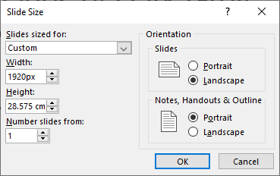

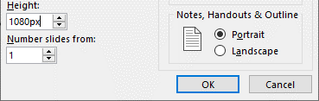


General rules
Common rules
Colour of the main text is not black, it is Dark Grey (RGB=30/31/31); always use this colour for text!
Secondary colour is Red (RGB=219/20/48) this can be used to highlight some text
For diagrams please use the C+ colour palette saved on the presentation documents unless a specific colour is required
In charts/graphs you can use darker tones of related colours – see examples slides
To produce hi-definition quality diagrams set page size to Widescreen (1920X1080px) this should be the default if you are using the template
If outlines are used on shapes, outline width must be 1.5px in weight
For presentations without section subtitle pages the page subtitle text would be a repetition of the presentation title, when a section subtitle page is used (in this case the common rules slide in this document) the page subtitle changes to that

Slide 7

Title & thankyou slides
Common rules
Title always capitalised and use Arial Bold font
There is a separate slide for when presenting for a partner or event please use that and insert the logo in the place holder next to the C+ logo, e.g. Money 20/20; the logo must not exceed the width/height of our logo and can only appear on the Title and Thank you slides
Name/subtitle should be in Arial Bold and 36pt
Job role/sub-subtitle should be Arial Bold 36pt

Slide 8
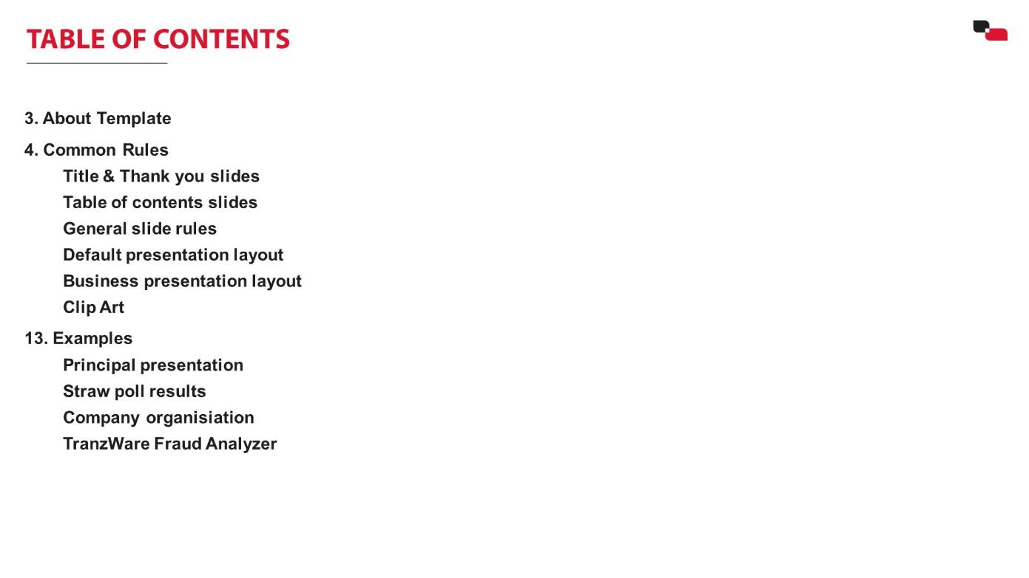
Table of contents slides
Common rules
Table of contents text must be positioned in the left of the slide.
Pages must be justified to the left
Keep it concise – maximum of 4-5 words and must fit on one line
Size of the font should never be less than 24pt

Slide 9

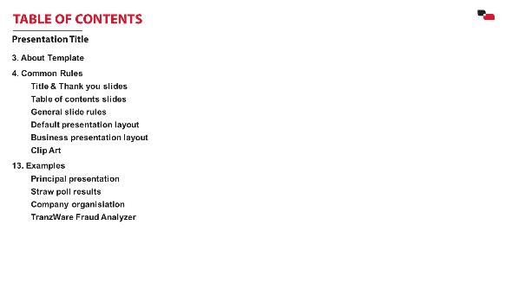
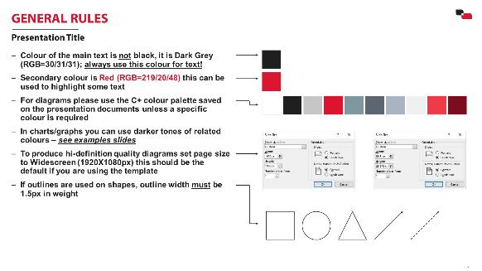

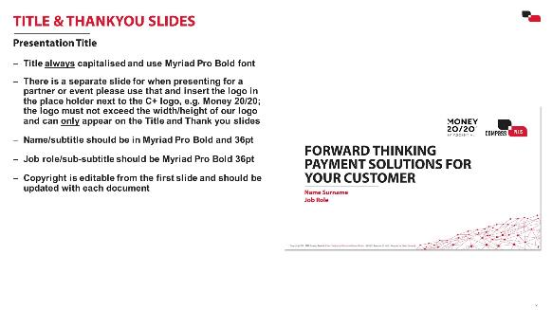

Presentation Slide layout
Common rules
Typical presentation includes
  Title slide
  Table of Contents/ Presentation plan
  Content slides
  Thank you slide
Long presentations can be divided into titled subsections using the section subtitle slide
  Section subtitle slide
For presentations that have multiple sections, use the section subtitle slide

Slide 10





Clipart/icons
Common rules
Do not use any other clipart apart from the approved ClipArt Library
The ClipArt Library is supplied in a separate presentation on Corporate Portal and is categorised according to use, examples include
If you need a clipart that does not yet exist, please contact the Marketing & PR Division
Do not use childish-looking, cartoon-like or fun-making shapes such as

Slide 11
Examples

Slide 12
Example 1: Principal Presentation
Examples
SHAREHOLDERS MEETING
Company Administration (CA)
Chief Executive Officer (CEO&P)
CEO’ Deputies & VPs
Company Directors
R&D Centre and Resource Hub
Coordinating Committee (СС)
Subject Management Bodies (SMB)
Administrative Department
Subject Commissions
Commercial Board (CB)
Business Support Department
Compensation & Benefits Commission
Project Board (PB)
Customers' Department
Nomenclature & Pricing Commission
Human Resources Directorate
Technical Board (TB)
Personnel Assessment Commission
IT Department
Working Groups (WG)
Social Issues Commission
Processing Department
Corporate Activities (CA)
Operation Performance Commission
Research & Development Centre
Retail Business Directorate
Business Development​ Commission
Management Bodies

Slide 13
Example 2: STRAW POLL RESULTS
Examples
What is the biggest issue for the payment and card industry now?

Slide 14
Example 3: Company organisation
Examples
Customer Services Managing Director
Deputy Manager of CD Business Processes
Deputy Manager of CD Resources
Quality Assurance Directorate
Customer Services Directorate
Project Customization Directorate
Product Testing Division
Project Management Division
Project Analysis Division
Release Testing Division
Technical Resource Bureau
Banking Products Division
TranzWare Testing Bureau
Project Automation Bureau
Applications Customization Division
TranzAxis Testing Bureau
Project Support Service
Retail Banking Bureau
Testing Automation Bureau
Printing Forms Bureau
Quality Control Bureau
Payment Application Bureau
Stress Testing Bureau
Customers’ Department Organisation

Slide 15
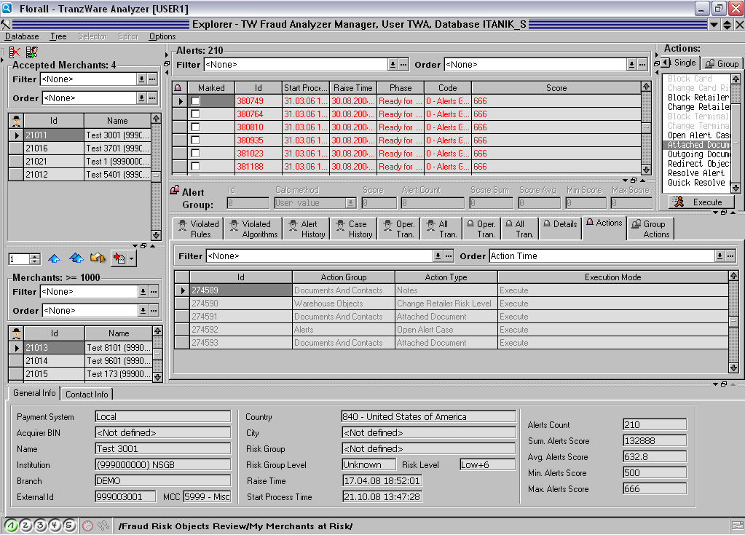
Example 4: TranzWare Fraud Analyzer
Examples
Operator Workplace

Slide 16
THANK YOU

